Slide 1
Project 12 Traffic light controller
Aanand Vishnu Nambudiripad – 18114001
Ishan Pandey – 18113061
Mohit Kumar – 18114049
Unmesh Kumar – 18114079

Slide 2
Block Diagram
Main Module
(Traffic Light Controller)
Clockwise
Horizontal Lights
Anticlockwise
Vertical Lights
Mode differentiator
Reset
Start counter
Clock
Clock
Mod 15 Counter
Out counter

Slide 3
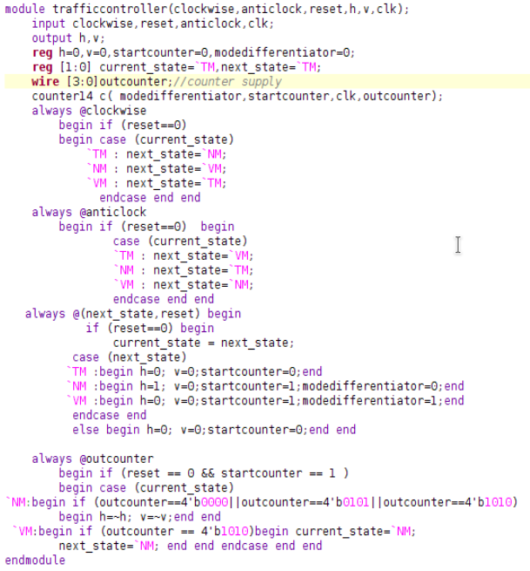
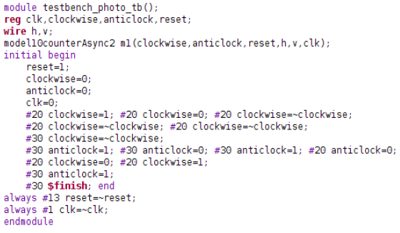
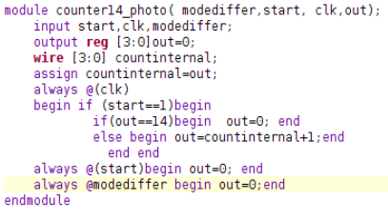

Slide 4
